Slide 1

Capstone Project
Shubham Kumar
Samarpit Chourasia
Santosh Kumar Ramani
Project Mentor Prof. Sanjay Verma

Slide 2
Introduction
Objective: Building a predictive model for coupon acceptance (food and beverage coupon – Yes/No) based on demographics, income, restaurant/café/bar visit behaviour, location of restaurant/café/bar visit, behaviour and the type of coupon offered etc. in the data set
Type of problem: Classification
Data Set Source: Machine Learning Repository
https://archive.ics.uci.edu/ml/datasets/in-vehicle+coupon+recommendation#
Data Set Size: 12684 (12599 – Removed duplicates)
Tools used: Excel, Python

Slide 3
List of Variables
Coupon types
Demographic
Age
Gender
Marital Status
‘Has Children’
Education
Occupation
Income
Car
Time to Expire – Coupon
Coupon of Restaurant < 5 mins, 15 mins, 25 mins
Type of Coupon
Bar
Carry out & Take Away
Coffee House
Restaurant < $20 per person
Restaurant – $20 to $50 per person
Frequency of visiting
Bar
Carry out & Take Away
Coffee House
Restaurant < $20 per person
Restaurant – $20 to $50 per person
Other Variables
Restaurant/Bar etc. in the same direction
Restaurant/Bar etc. in the opposite direction
Destination
Passengers Accompanying
Weather, Temperature
Time of the day

Slide 4
Overall Approach
Data Cleaning
Patterns in Data – Exploratory Analysis
Approach
Exploring Algorithms
Compiling Results
Model Selection
Model Implementation

Slide 5
Overall Approach
Data Cleaning
Patterns in Data – Exploratory Analysis
Finalising Approach
Exploring Algorithms
Compiling Results
Model Selection
Model Implementation

Slide 6
Data Cleaning & Preparation
Attribute type checking & removal
Labelling the attributes
Appending the dataset
Data Cleaning and Preparation

Slide 7
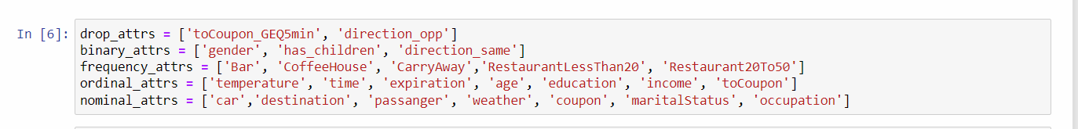
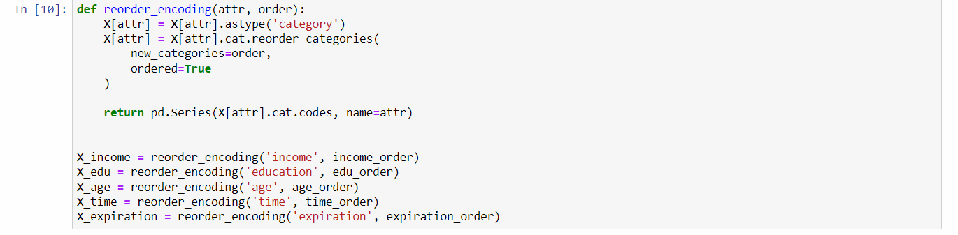
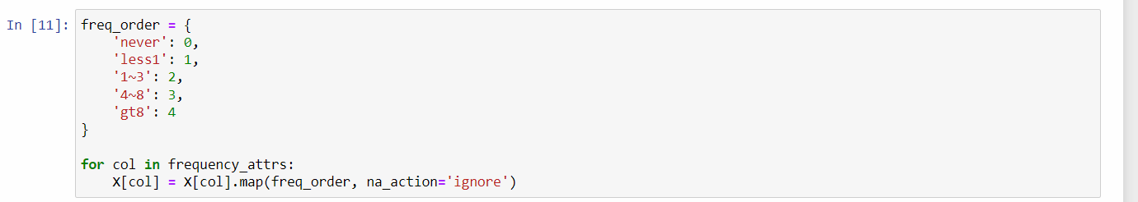
Data Cleaning & Preparation
Attribute identifying, checking, removal
Attribute reorder encoding
Ordering attributes

Slide 8
Overall Approach
Data Cleaning
Patterns in Data – Exploratory Analysis
Approach
Exploring Algorithms
Compiling Results
Model Selection
Model Implementation

Slide 9
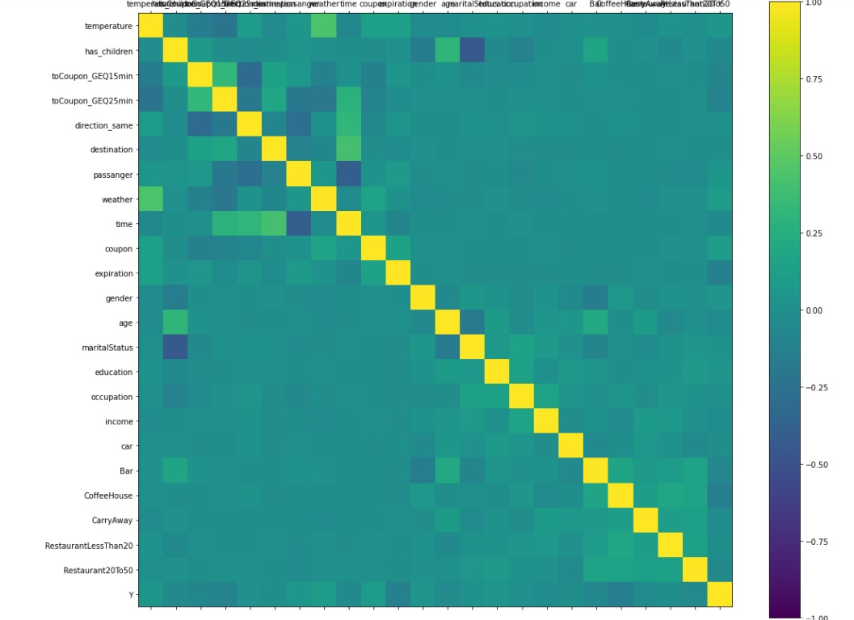
Correlation Matrix
Correlation does not exceed +/- 0.5

Slide 10
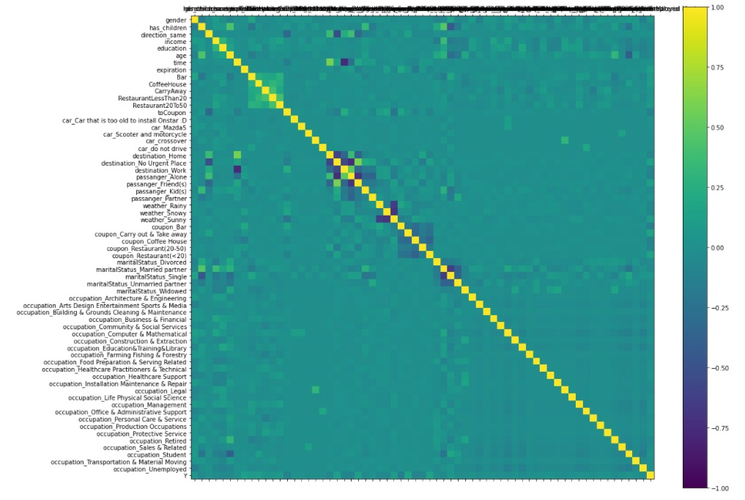
Correlation Matrix
Negative Correlation
Destination_Work vs Time (-ve)
Destination_No Urgent Place vs Passenger_Alone (-ve)
+ ve correlation – 0.59 max

Slide 11
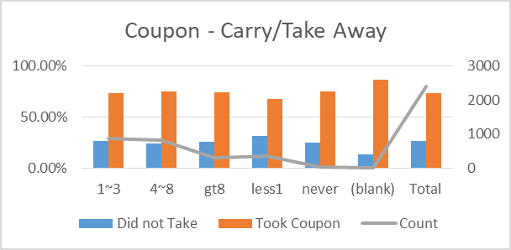
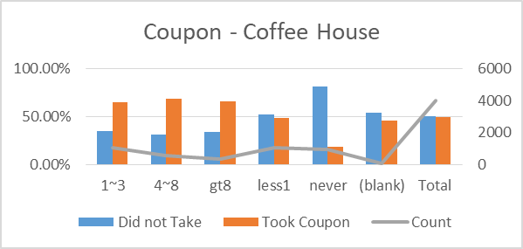
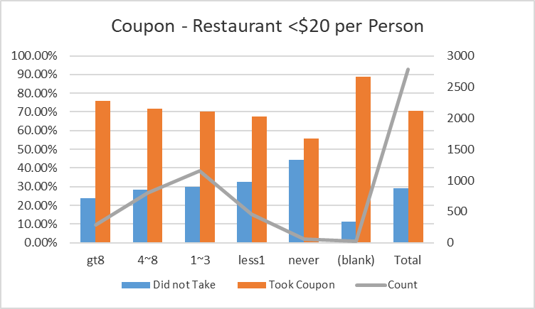
Exploratory Analysis
Type of Coupon | Bar | Carry out & Take away | Coffee House | Restaurant(<$20) | Restaurant($20-$50) | Total
Proportion | 16% | 19% | 32% | 22% | 12% | 100%
Proportion of Coupon Takers is higher irrespective of visit behaviour
Proportion of Coupon Takers is a function of visit behaviour
Proportion of Coupon Takers is higher irrespective of visit behaviour

Slide 12
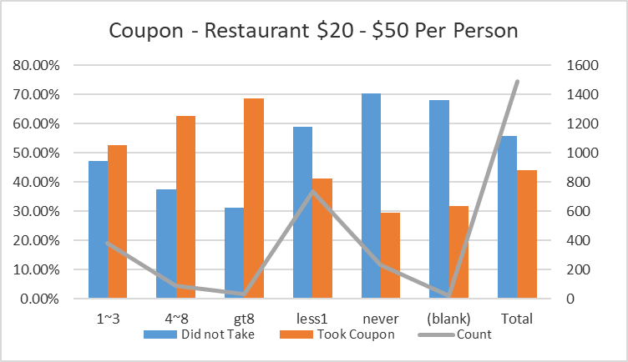
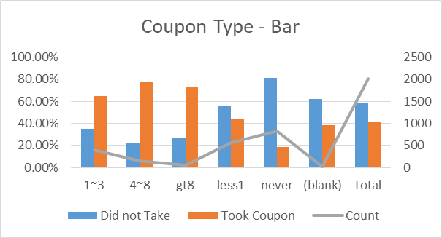
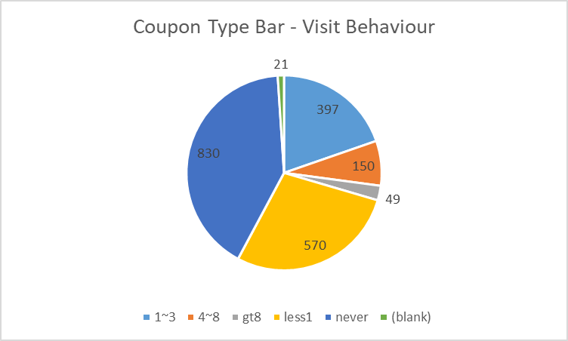
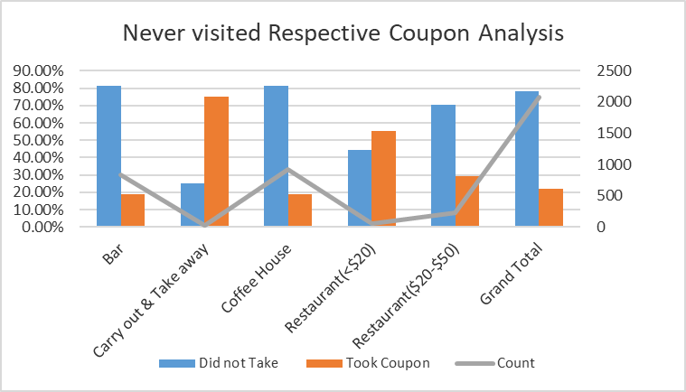
Exploratory Analysis
Proportion of Coupon Takers is a function of visit behaviour
Proportion of Coupon Takers is a function of visit behaviour
Exclude
Proportion of Coupon Takers is a function of visit behaviour
Carry & Restaurant < $20 per peson Coupon has higher acceptance even in users who never visited/used them

Slide 13
Overall Approach
Data Cleaning
Patterns in Data – Exploratory Analysis
Approach
Exploring Algorithms
Compiling Results
Model Selection
Model Implementation

Slide 14
Classification algorithm – Different Clusters/Cohorts
Classification
Data Set – 1 cluster
Data Set – Multiple Clusters (Clustering Algorithm)
Data Set – Multiple Clusters (Rule Based Cohorts)

Slide 15
Overall Approach
Data Cleaning
Patterns in Data – Exploratory Analysis
Approach
Exploring Algorithms
Compiling Results
Model Selection
Model Implementation

Slide 16
Classification Algorithm – Entire Data set
Classification
Data Set – 1 cluster
Data Set – Multiple Clusters (Clustering Algorithm)
Data Set – Multiple Clusters (Rule Based Cohorts)

Slide 17
Data Set -1 cluster (Algorithms)
Logistic Regression
Decision Tree
Random Forest
Support Vector Machines
PCA

Slide 18
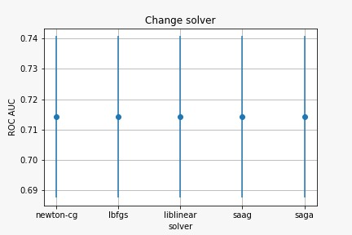
Data Set -1 cluster (Logistic Regression)
At 0.5 probability cut off
Train Data |  | Predicted
Actual |  | 0 | 1
 | 0 | 2583 | 1820
 | 1 | 1350 | 4326
Test Data |  | Predicted
Actual |  | 0 | 1
 | 0 | 589 | 458
 | 1 | 362 | 1111
 | Probability Threshold
Metric | 0.3 | 0.4 | 0.45 | 0.5 | 0.6 | 0.7
Sensitivity | 95% | 87% | 82% | 75% | 61% | 43%
Specificity | 20% | 40% | 47% | 56% | 71% | 85%
Precision | 62% | 67% | 68% | 71% | 75% | 79%
Accuracy | 64% | 68% | 67% | 67% | 65% | 60%
AUC | 57% | 64% | 64% | 66% | 66% | 64%
 | Train
Sensitivity | 76.2%
Specificity | 58.7%
Accuracy | 68.5%
 | Test
Sensitivity | 75.4%
Specificity | 56.3%
Accuracy | 67.5%
Accuracy is not very high
Explored various Probabilities

Slide 19
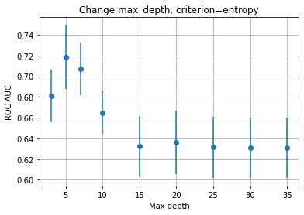
Data Set -1 cluster (Decision Tree)
Train Data |  | Predicted
Actual |  | 0 | 1
 | 0 | 2180 | 2223
 | 1 | 968 | 4708
Test Data |  | Predicted
Actual |  | 0 | 1
 | 0 | 501 | 546
 | 1 | 236 | 1237
 | Train
Sensitivity | 82.9%
Specificity | 49.5%
Accuracy | 68.3%
 | Test
Sensitivity | 84.0%
Specificity | 47.9%
Accuracy | 69.0%
Decision Tree Splits (Key Variables) -
I Split: Coupon Type (Carry out & take away)
II Split: Coupon Type (Restaurant < $20), Time of day,
III Split: Coupon Type (Bar), Destination to Coupon (15 mins), Weather type, Time of the day
Accuracy & Sensitivity is higher than logistic regression

Slide 20
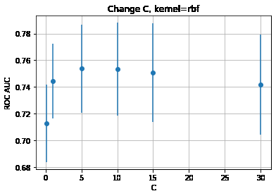
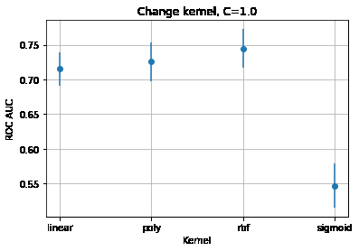
Data Set -1 cluster (SVM)
Train Data |  | Predicted
Actual |  | 0 | 1
 | 0 | 3222 | 1181
 | 1 | 785 | 4891
Test Data |  | Predicted
Actual |  | 0 | 1
 | 0 | 711 | 336
 | 1 | 275 | 1198
 | Train
Sensitivity | 86.2%
Specificity | 73.2%
Accuracy | 80.5%
 | Test
Sensitivity | 81.3%
Specificity | 67.9%
Accuracy | 75.8%
Accuracy and Sensitivity measures are higher than Decision Tree

Slide 21
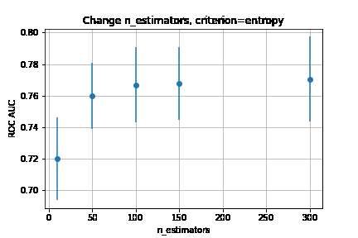
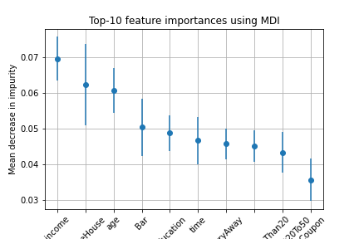
Data Set -1 cluster (Random Forest)
Train Data |  | Predicted
Actual |  | 0 | 1
 | 0 | 4392 | 11
 | 1 | 6 | 5670
Test Data |  | Predicted
Actual |  | 0 | 1
 | 0 | 717 | 330
 | 1 | 252 | 1221
 | Train
Sensitivity | 99.9%
Specificity | 99.8%
Accuracy | 99.8%
 | Test
Sensitivity | 82.9%
Specificity | 68.5%
Accuracy | 76.9%
Over fitting in Train data
Accuracy and Sensitivity are the highest

Slide 22
Data Set – PCA
Logistic Regression
Decision Tree
Train Data |  | Predicted
Actual |  | 0 | 1
 | 0 | 2584 | 1819
 | 1 | 1351 | 4325
Test Data |  | Predicted
Actual |  | 0 | 1
 | 0 | 589 | 458
 | 1 | 362 | 1111
Train Data |  | Predicted
Actual |  | 0 | 1
 | 0 | 2492 | 1911
 | 1 | 1389 | 4287
Test Data |  | Predicted
Actual |  | 0 | 1
 | 0 | 559 | 488
 | 1 | 364 | 1109
 | Train
Sensitivity | 76.2%
Specificity | 58.7%
Accuracy | 68.5%
 | Test
Sensitivity | 75.4%
Specificity | 56.3%
Accuracy | 67.4%
 | Train
Sensitivity | 75.5%
Specificity | 56.6%
Accuracy | 67.2%
 | Test
Sensitivity | 75.3%
Specificity | 53.4%
Accuracy | 66.1%
SVM
Random Forest
Train Data |  | Predicted
Actual |  | 0 | 1
 | 0 | 4033 | 370
 | 1 | 201 | 5475
Test Data |  | Predicted
Actual |  | 0 | 1
 | 0 | 703 | 344
 | 1 | 323 | 1150
Train Data |  | Predicted
Actual |  | 0 | 1
 | 0 | 4392 | 11
 | 1 | 6 | 5670
Test Data |  | Predicted
Actual |  | 0 | 1
 | 0 | 688 | 359
 | 1 | 267 | 1206
 | Train
Sensitivity | 96.5%
Specificity | 91.6%
Accuracy | 94.3%
 | Test
Sensitivity | 78.1%
Specificity | 67.1%
Accuracy | 73.5%
 | Train
Sensitivity | 99.9%
Specificity | 99.8%
Accuracy | 99.8%
 | Test
Sensitivity | 81.9%
Specificity | 65.7%
Accuracy | 75.1%
Low Sensitivity & Low accuracy observed

Slide 23
Data Set –1 cluster (Summary -Classification Algorithms)
Type of Partition | Metric | Logistic Regression | Decision Tree | SVM | Random Forest | Random Forest with PCA
Train | Sensitivity | 76.20% | 82.90% | 86.20% | 99.90% | 99.90%
 | Specificity | 58.70% | 49.50% | 73.20% | 99.80% | 99.80%
 | Accuracy | 68.50% | 68.30% | 80.50% | 99.80% | 99.80%
Test | Sensitivity | 75.40% | 84.00% | 81.30% | 82.90% | 81.9%
 | Specificity | 56.30% | 47.90% | 67.90% | 68.50% | 65.7%
 | Accuracy | 67.50% | 69.00% | 75.80% | 76.90% | 75.1%
Accuracy highest for Random Forest.
While sensitivity is marginally higher for Decision Tree, Random Forest does a better job at balancing Sensitivity & Specificity without much loss in accuracy

Slide 24
Approach
Classification
Data Set – 1 cluster
Data Set – Multiple Clusters (Clustering Algorithm)
Data Set – Multiple Clusters (Rule Based Cohorts)
Clustering through algorithms – Challenges in identifying the nature of clusters

Slide 25
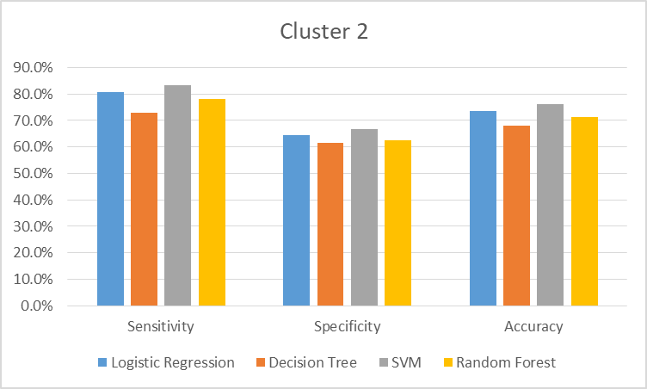
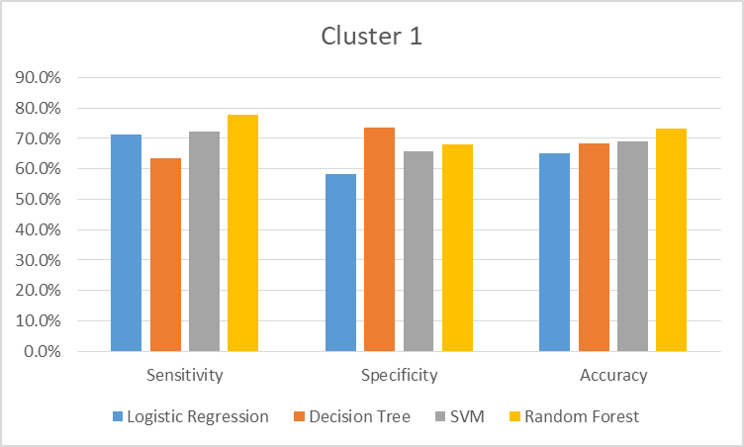
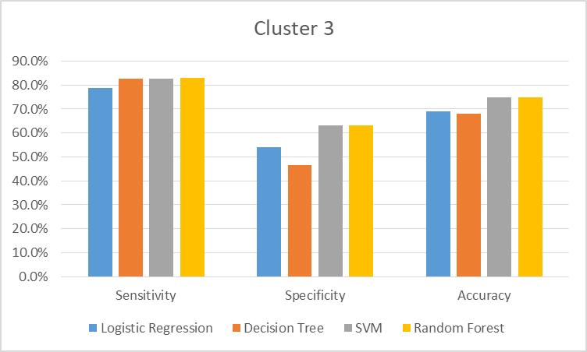
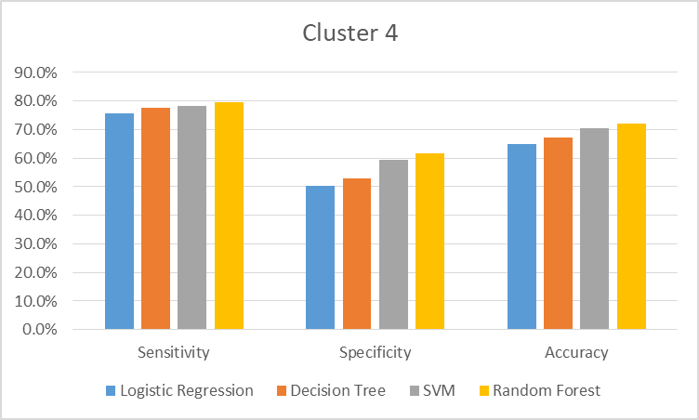
Results for 5 Clusters – Test data (Lower Accuracy)

Slide 26
Approach
Classification
Data Set – 1 cluster
Data Set – Multiple Clusters (Clustering Algorithm)
Data Set – Multiple Clusters (Rule Based Cohorts)

Slide 27
Multiple clusters (Rule Based Clusters - Bar)
Logistic Regression
Decision Tree
Train Data |  | Predicted
Actual |  | 0 | 1
 | 0 | 798 | 156
 | 1 | 264 | 390
Test Data |  | Predicted
Actual |  | 0 | 1
 | 0 | 192 | 40
 | 1 | 76 | 94
Train Data |  | Predicted
Actual |  | 0 | 1
 | 0 | 728 | 226
 | 1 | 174 | 480
Test Data |  | Predicted
Actual |  | 0 | 1
 | 0 | 170 | 62
 | 1 | 56 | 114
 | Train
Sensitivity | 59.6%
Specificity | 83.6%
Accuracy | 73.9%
 | Test
Sensitivity | 55.3%
Specificity | 82.8%
Accuracy | 55.3%
 | Train
Sensitivity | 73.4%
Specificity | 76.3%
Accuracy | 75.1%
 | Test
Sensitivity | 67.1%
Specificity | 73.3%
Accuracy | 70.6%
SVM
Random Forest
Train Data |  | Predicted
Actual |  | 0 | 1
 | 0 | 868 | 86
 | 1 | 141 | 513
Test Data |  | Predicted
Actual |  | 0 | 1
 | 0 | 192 | 40
 | 1 | 58 | 112
Train Data |  | Predicted
Actual |  | 0 | 1
 | 0 | 954 | 0
 | 1 | 0 | 654
Test Data |  | Predicted
Actual |  | 0 | 1
 | 0 | 189 | 43
 | 1 | 53 | 117
 | Train
Sensitivity | 78.4%
Specificity | 91.0%
Accuracy | 85.9%
 | Test
Sensitivity | 65.9%
Specificity | 82.8%
Accuracy | 75.6%
 | Train
Sensitivity | 100.0%
Specificity | 100.0%
Accuracy | 100.0%
 | Test
Sensitivity | 68.8%
Specificity | 81.5%
Accuracy | 76.1%
Random forest has the best metrics

Slide 28
Multiple clusters (Rule Based Clusters - Carry)
Logistic Regression
Decision Tree
Train Data |  | Predicted
Actual |  | 0 | 1
 | 0 | 82 | 402
 | 1 | 47 | 1337
Test Data |  | Predicted
Actual |  | 0 | 1
 | 0 | 24 | 113
 | 1 | 14 | 317
Train Data |  | Predicted
Actual |  | 0 | 1
 | 0 | 99 | 385
 | 1 | 41 | 1343
Test Data |  | Predicted
Actual |  | 0 | 1
 | 0 | 23 | 114
 | 1 | 13 | 318
 | Train
Sensitivity | 96.6%
Specificity | 16.9%
Accuracy | 76.0%
 | Test
Sensitivity | 95.8%
Specificity | 17.5%
Accuracy | 72.9%
 | Train
Sensitivity | 97.0%
Specificity | 20.5%
Accuracy | 77.2%
 | Test
Sensitivity | 96.1%
Specificity | 16.8%
Accuracy | 72.9%
SVM
Random Forest
Train Data |  | Predicted
Actual |  | 0 | 1
 | 0 | 193 | 291
 | 1 | 17 | 1367
Test Data |  | Predicted
Actual |  | 0 | 1
 | 0 | 27 | 110
 | 1 | 21 | 310
Train Data |  | Predicted
Actual |  | 0 | 1
 | 0 | 478 | 6
 | 1 | 2 | 1382
Test Data |  | Predicted
Actual |  | 0 | 1
 | 0 | 32 | 105
 | 1 | 24 | 307
 | Train
Sensitivity | 98.8%
Specificity | 39.9%
Accuracy | 83.5%
 | Test
Sensitivity | 93.7%
Specificity | 19.7%
Accuracy | 72.0%
 | Train
Sensitivity | 99.9%
Specificity | 98.8%
Accuracy | 99.6%
 | Test
Sensitivity | 92.7%
Specificity | 23.4%
Accuracy | 72.4%
Random forest has highest accuracy with very high sensitivity but specificity is sacrificed

Slide 29
Multiple clusters (Rule Based Clusters - Coffee)
Logistic Regression
Decision Tree
Train Data |  | Predicted
Actual |  | 0 | 1
 | 0 | 1143 | 446
 | 1 | 441 | 1160
Test Data |  | Predicted
Actual |  | 0 | 1
 | 0 | 286 | 125
 | 1 | 127 | 260
Train Data |  | Predicted
Actual |  | 0 | 1
 | 0 | 1090 | 499
 | 1 | 346 | 1255
Test Data |  | Predicted
Actual |  | 0 | 1
 | 0 | 260 | 151
 | 1 | 99 | 288
 | Train
Sensitivity | 72.5%
Specificity | 71.9%
Accuracy | 72.2%
 | Test
Sensitivity | 67.2%
Specificity | 69.6%
Accuracy | 68.4%
 | Train
Sensitivity | 78.4%
Specificity | 68.6%
Accuracy | 73.5%
 | Test
Sensitivity | 74.4%
Specificity | 63.3%
Accuracy | 68.7%
SVM
Random Forest
Train Data |  | Predicted
Actual |  | 0 | 1
 | 0 | 1278 | 311
 | 1 | 232 | 1369
Test Data |  | Predicted
Actual |  | 0 | 1
 | 0 | 297 | 114
 | 1 | 93 | 294
Train Data |  | Predicted
Actual |  | 0 | 1
 | 0 | 1588 | 1
 | 1 | 1 | 1600
Test Data |  | Predicted
Actual |  | 0 | 1
 | 0 | 316 | 95
 | 1 | 89 | 298
 | Train
Sensitivity | 85.5%
Specificity | 80.4%
Accuracy | 83.0%
 | Test
Sensitivity | 76.0%
Specificity | 72.3%
Accuracy | 74.1%
 | Train
Sensitivity | 99.9%
Specificity | 99.9%
Accuracy | 99.9%
 | Test
Sensitivity | 77.0%
Specificity | 76.9%
Accuracy | 76.9%
Random forest has highest accuracy with balanced sensitivity and specificity

Slide 30
Multiple clusters (Rule Based Clusters – R20)
Logistic Regression
Decision Tree
Train Data |  | Predicted
Actual |  | 0 | 1
 | 0 | 245 | 407
 | 1 | 121 | 1449
Test Data |  | Predicted
Actual |  | 0 | 1
 | 0 | 59 | 101
 | 1 | 36 | 360
Train Data |  | Predicted
Actual |  | 0 | 1
 | 0 | 279 | 373
 | 1 | 131 | 1439
Test Data |  | Predicted
Actual |  | 0 | 1
 | 0 | 65 | 95
 | 1 | 43 | 353
 | Train
Sensitivity | 92.3%
Specificity | 37.6%
Accuracy | 76.2%
 | Test
Sensitivity | 90.9%
Specificity | 36.9%
Accuracy | 75.4%
 | Train
Sensitivity | 91.7%
Specificity | 42.8%
Accuracy | 77.3%
 | Test
Sensitivity | 89.1%
Specificity | 40.6%
Accuracy | 75.2%
SVM
Random Forest
Train Data |  | Predicted
Actual |  | 0 | 1
 | 0 | 368 | 284
 | 1 | 45 | 1525
Test Data |  | Predicted
Actual |  | 0 | 1
 | 0 | 79 | 81
 | 1 | 31 | 365
Train Data |  | Predicted
Actual |  | 0 | 1
 | 0 | 652 | 0
 | 1 | 2 | 1568
Test Data |  | Predicted
Actual |  | 0 | 1
 | 0 | 84 | 76
 | 1 | 34 | 362
 | Train
Sensitivity | 97.1%
Specificity | 56.4%
Accuracy | 85.2%
 | Test
Sensitivity | 92.2%
Specificity | 49.4%
Accuracy | 79.9%
 | Train
Sensitivity | 99.9%
Specificity | 100.0%
Accuracy | 99.9%
 | Test
Sensitivity | 91.4%
Specificity | 52.5%
Accuracy | 80.2%
High Sensitivity and High Accuracy observed

Slide 31
Multiple clusters (Rule Based Clusters – R20 to R 50)
Logistic Regression
Decision Tree
Train Data |  | Predicted
Actual |  | 0 | 1
 | 0 | 503 | 154
 | 1 | 230 | 302
Test Data |  | Predicted
Actual |  | 0 | 1
 | 0 | 139 | 35
 | 1 | 52 | 72
Train Data |  | Predicted
Actual |  | 0 | 1
 | 0 | 517 | 140
 | 1 | 260 | 272
Test Data |  | Predicted
Actual |  | 0 | 1
 | 0 | 137 | 37
 | 1 | 69 | 55
 | Train
Sensitivity | 56.8%
Specificity | 76.6%
Accuracy | 67.7%
 | Test
Sensitivity | 58.1%
Specificity | 79.9%
Accuracy | 70.8%
 | Train
Sensitivity | 51.1%
Specificity | 78.7%
Accuracy | 66.4%
 | Test
Sensitivity | 44.4%
Specificity | 78.7%
Accuracy | 64.4%
SVM
Random Forest
Train Data |  | Predicted
Actual |  | 0 | 1
 | 0 | 566 | 91
 | 1 | 111 | 421
Test Data |  | Predicted
Actual |  | 0 | 1
 | 0 | 130 | 44
 | 1 | 56 | 68
Train Data |  | Predicted
Actual |  | 0 | 1
 | 0 | 656 | 1
 | 1 | 0 | 532
Test Data |  | Predicted
Actual |  | 0 | 1
 | 0 | 134 | 40
 | 1 | 61 | 63
 | Train
Sensitivity | 79.1%
Specificity | 86.1%
Accuracy | 83.0%
 | Test
Sensitivity | 54.8%
Specificity | 74.7%
Accuracy | 66.4%
 | Train
Sensitivity | 100.0%
Specificity | 99.8%
Accuracy | 99.9%
 | Test
Sensitivity | 50.8%
Specificity | 77.0%
Accuracy | 66.1%
Low Sensitivity & Low accuracy observed

Slide 32
Overall Approach
Data Cleaning
Patterns in Data – Exploratory Analysis
Approach
Exploring Algorithms
Compiling Results
Model Selection
Model Implementation

Slide 33
Multiple clusters (Classification Algorithms)
Random Forest | Sensitivity | Specificity | Accuracy | Population
Bar | 68.8% | 81.50% | 76.10% | 16%
Carry | 92.70% | 23.40% | 72.40% | 19%
Coffee | 77.00% | 76.90% | 76.90% | 32%
R20 | 91.40% | 52.50% | 80.20% | 22%
R20 to 50 | 50.80% | 77% | 66.10% | 12%
Total | 78.7% | 62.2% | 75.4% | 100%
Single Cluster | Sensitivity | Specificity | Accuracy
Total | 82.90% | 68.50% | 76.90%
Breaking it into Different rule based clusters does not increase accuracy

Slide 34
Rule based clusters (Classification Algorithms)
Entire Sample
Exclude ‘Never visited/used’ cohort for respective Coupon types
Run Classification Algorithms for the rest of the sample

Slide 35
Rule based Cluster excluding ‘Never Visited’
Never Visited/Used | Sensitivity | Specificity | Accuracy | Population
Random Forest | 26.8% | 96.10% | 82.40% | 2072
Random Forest | Sensitivity | Specificity | Accuracy | Population% | Population
Bar | 82% | 53% | 70% | 11% | 1180
Carry | 93% | 27% | 76% | 22% | 2305
Coffee | 84% | 63% | 75% | 29% | 3061
R20 | 91% | 43.80% | 77% | 26% | 2724
R20 to 50 | 58% | 81% | 70% | 12% | 1257
Total | 84.7% | 51.4% | 74% | 100% | 10527
Entire Population Excluding ‘Never’ but running Random Forest Algorithm on different populations

Slide 36
Multiple clusters (Rule Based Clusters – Clubbed)
Logistic Regression
Decision Tree
Train Data |  | Predicted
Actual |  | 0 | 1
 | 0 | 1227 | 1873
 | 1 | 748 | 4573
Test Data |  | Predicted
Actual |  | 0 | 1
 | 0 | 317 | 413
 | 1 | 181 | 1195
Train Data |  | Predicted
Actual |  | 0 | 1
 | 0 | 517 | 140
 | 1 | 260 | 272
Test Data |  | Predicted
Actual |  | 0 | 1
 | 0 | 137 | 37
 | 1 | 69 | 55
 | Train
Sensitivity | 39.6%
Specificity | 85.9%
Accuracy | 68.9%
 | Test
Sensitivity | 86.8%
Specificity | 43.4%
Accuracy | 71.7%
 | Train
Sensitivity | 93.9%
Specificity | 23.7%
Accuracy | 68.0%
 | Test
Sensitivity | 94.5%
Specificity | 27.4%
Accuracy | 71.2%
SVM
Random Forest
Train Data |  | Predicted
Actual |  | 0 | 1
 | 0 | 1885 | 1215
 | 1 | 468 | 4853
Test Data |  | Predicted
Actual |  | 0 | 1
 | 0 | 399 | 331
 | 1 | 185 | 1191
Train Data |  | Predicted
Actual |  | 0 | 1
 | 0 | 3093 | 7
 | 1 | 8 | 5313
Test Data |  | Predicted
Actual |  | 0 | 1
 | 0 | 398 | 332
 | 1 | 173 | 1203
 | Train
Sensitivity | 91.2%
Specificity | 60.8%
Accuracy | 80.0%
 | Test
Sensitivity | 86.6%
Specificity | 54.7%
Accuracy | 75.4%
 | Train
Sensitivity | 99.8%
Specificity | 99.8%
Accuracy | 99.8%
 | Test
Sensitivity | 87.4%
Specificity | 54.5%
Accuracy | 76.0%
Sensitivity and accuracy is higher

Slide 37
Overall Approach
Data Cleaning
Patterns in Data – Exploratory Analysis
Approach
Exploring Algorithms
Compiling Results
Model Selection
Model Implementation

Slide 38
Data Set – Model Results(Classification Algorithms)
Never Visited/Used | Sensitivity | Specificity | Accuracy | Population
Random Forest | 26.8% | 96.10% | 82.40% | 2072
Model 1 – ‘Never Visited/Used
Model 2
Random Forest | Sensitivity | Specificity | Accuracy | Population% | Population
Bar | 82% | 53% | 70% | 11% | 1180
Carry | 93% | 27% | 76% | 22% | 2305
Coffee | 84% | 63% | 75% | 29% | 3061
R20 | 91% | 43.80% | 77% | 26% | 2724
R20 to 50 | 58% | 81% | 70% | 12% | 1257
Total | 84.7% | 51.4% | 74% | 100% | 10527
Clubbed Cluster | Sensitivity | Specificity | Accuracy | Population
Total | 87.4% | 54.5% | 76.00% | 10527
I Cluster | 82.9% | 68.5% | 76.9% | 12599
Clubbed Cluster Without R20 to R50 | Sensitivity | Specificity | Accuracy | Population
Total | 89.30% | 51.1% | 76.6% | 9270
I Cluster | 82.9% | 68.5% | 76.9% | 12599
Entire Population Excluding ‘Never’ but running Random Forest Algorithm on different populations
Weighted Average accuracy for overall population is 78%
Model 3

Slide 39
Overall Approach
Data Cleaning
Patterns in Data – Exploratory Analysis
Approach
Exploring Algorithms
Compiling Results
Model Selection
Model Implementation

Slide 40
Model Implementation
Ask Question on Visit to Restaurant <$20 per person , Bar, Coffee , Carry out and take away and Restaurant $20 -$50 per person
Run Model I – ‘Never Visited respective type of category’ Model
Ask if the indiviual would visit a restaurant which has average expenditure more than $20 per person
Run Model which contains all coupon type – Model 2
Run Model without R20 to 50 - Model 3
No
Yes
Yes
No

Slide 41
Acknowledgements
IIMA – ‘The Institute’
Prof Laha, Prof Sanjay, Prof Ankur, Prof Kavita and other members of the facaulty
Rohit, Hetal & Hemal
VC Now Staff

Slide 42
Thank you

Slide 43
Appendix

Slide 44
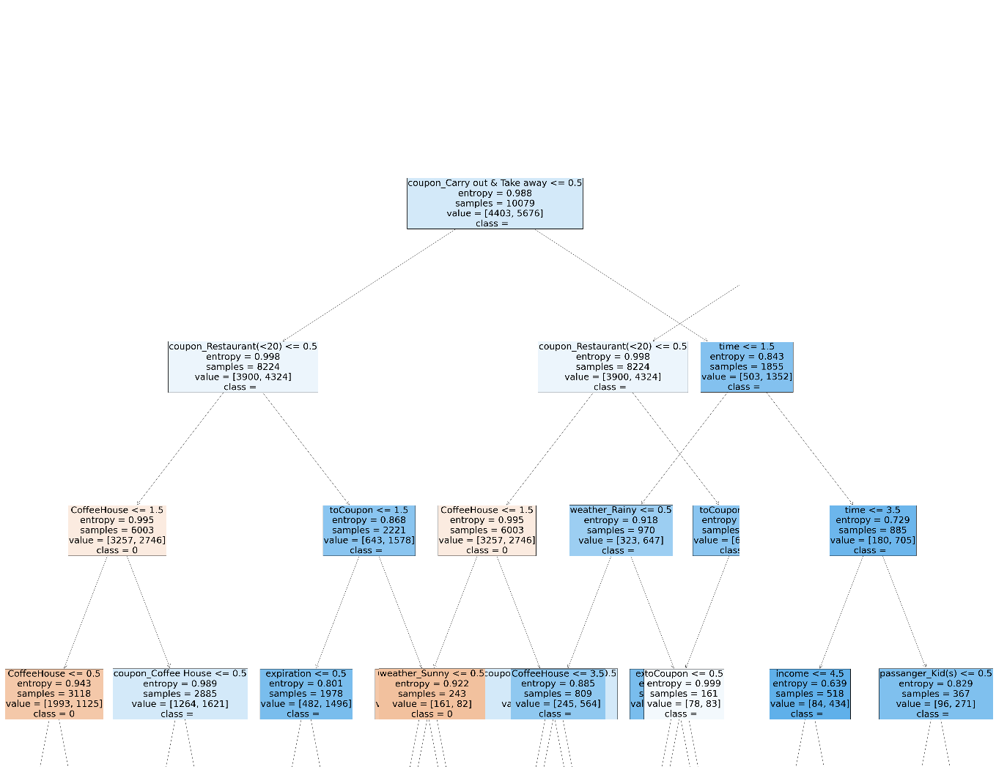
Decision Tree

Slide 45
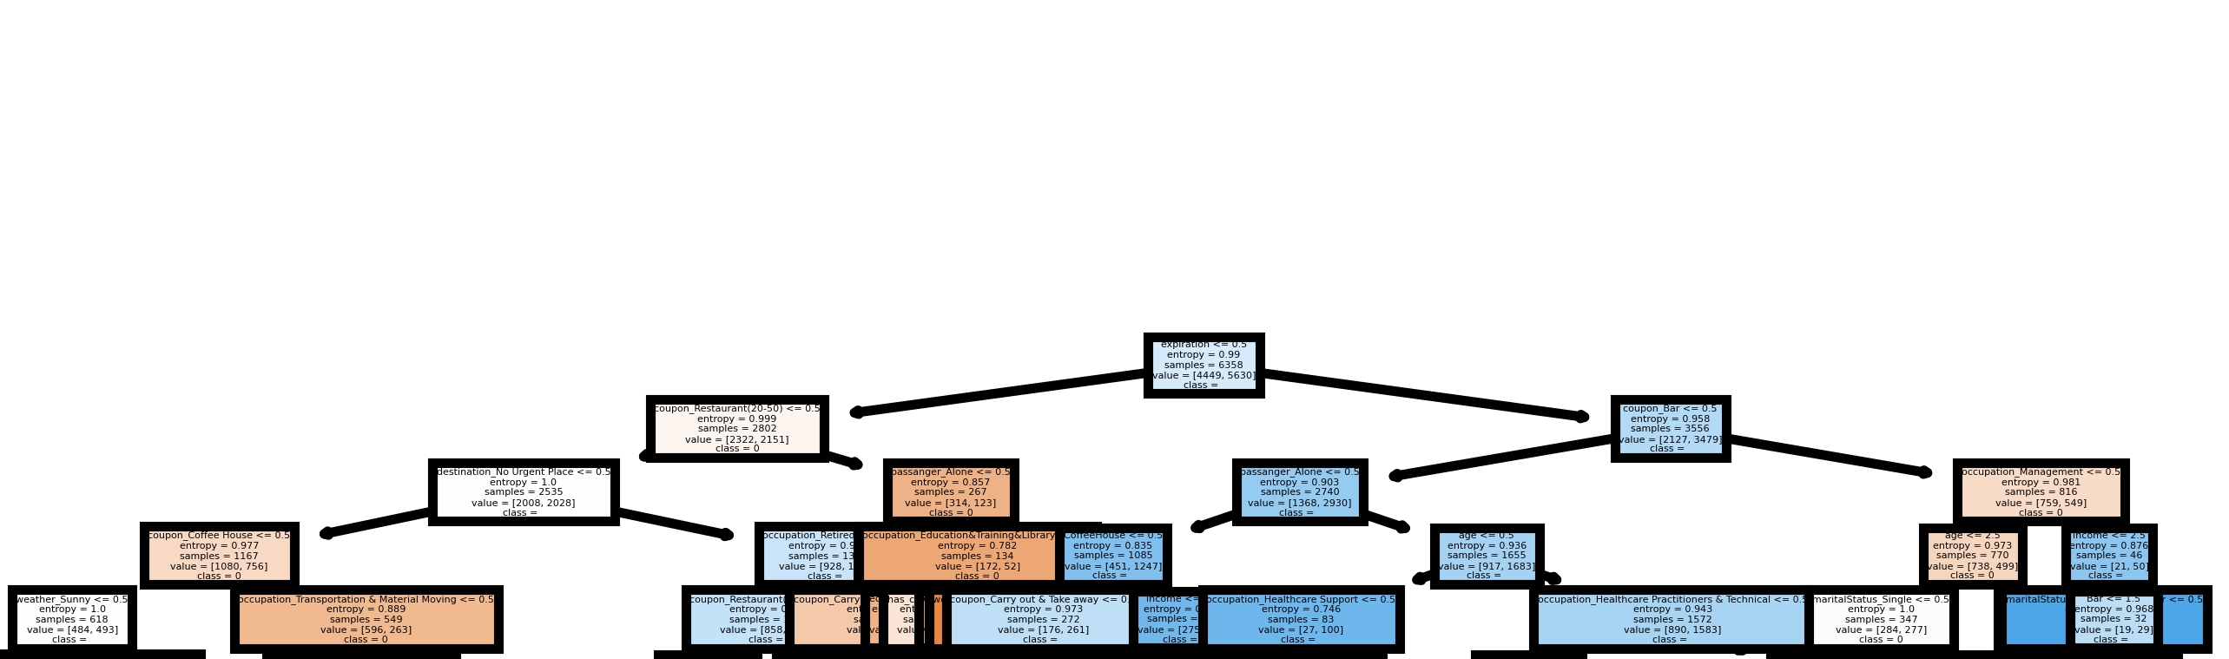
Random Forest

Slide 46
All Model Snapshot
Different Model | Accuracy
Naive Bayes Classifier | 61.5%
KNN Classifier | 66.5%
BAGGING with Decision tree Classifier | 71.3%
Extra tree Classifier | 74.6%
ADC Boosting | 68.4%
GDC Boosting: | 72.3%
BAGGING Random Forest | 75.7%
multinomial Classifier | 65.3%
Ensembling Voting | 70.1%

Slide 47
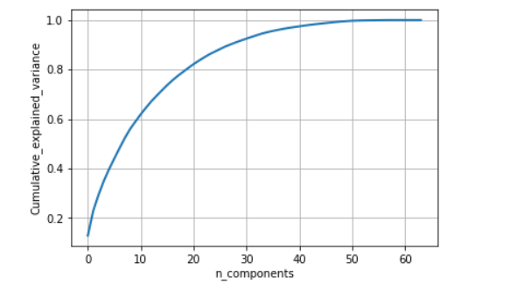
PCA
Total variable: 64
Reduced variable= 30
Information loss= 10%

